Slide 1
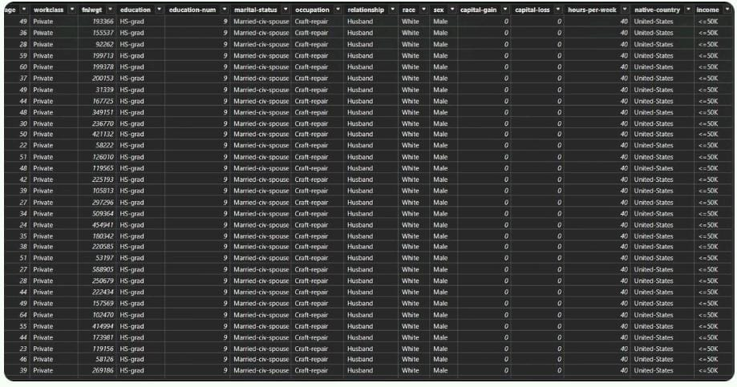
Income Evaluation
Dataset Overview:
The dataset income_evaluation.csv contains 32,561 records with 15 columns. It is related to income classification, where the target variable is income, indicating whether a person's income is <=50kor >50k.
The income_evaluation.csv dataset contains structured tabular data with a mix of categorical and numerical data.
Numerical Data 's are age, fnlwgt, education-num ,capital-gain, capital-loss, hours-per-week.
Data set contains two types categorical data's one is Nominal and another is Cardinal.
Nominal data are work class, marital-status, occupation, relationship, race, sex ,native-country.
Cardinal data: education.
income (Binary)

Slide 2
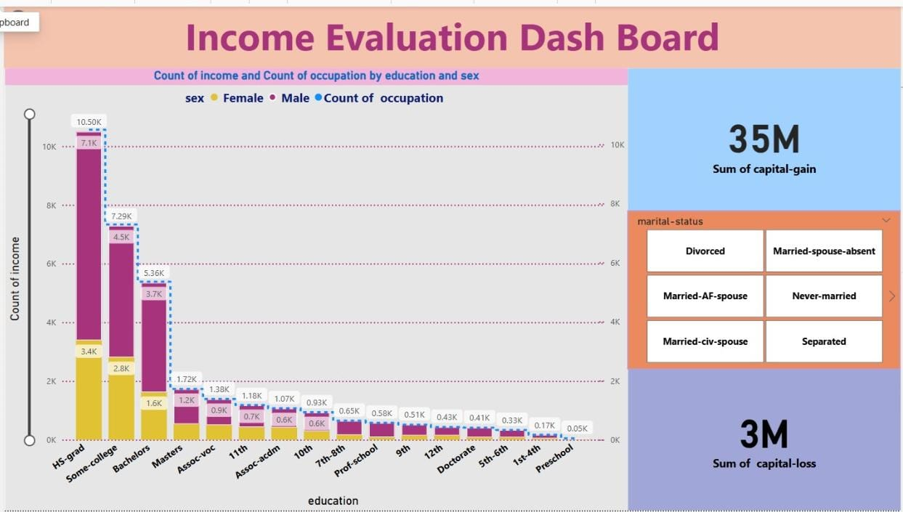
1. Count of income and count of occupation by education and sex:
The picture contains Line and stacked column chart, one slicer and two cards.
The Line and stacked column chart display the count of income and count of occupation by education and sex.
From the Line and stacked column chart we can count number of earnings in occupation. we can identify the education details in sex(male/female).
Similarly, we see the type of education details like (e.g.12th ,Doctorate, Prof-school or pre school etc.)
Clicking on the bar of a chart we can see the changes of values in card.

Slide 3
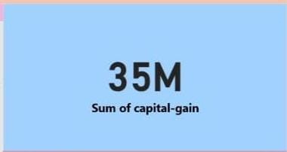
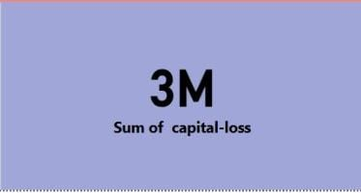
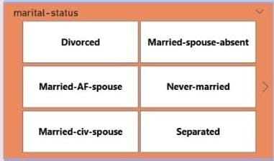
2.Card:
capital-gain: Extra income from investments, stocks, or business profits.
capital-loss: Investment losses, which reduce overall income.
Card display the value max of capital -gain and max of capital-loss of earner.
3.Slicer:
Here, With slicer we can choose marital - status.
with marital- slicer we can count number of earners on the particular person. like(Divorced, separated and never-married)
Selecting on value of slicer we can see changes in values on Line and stacked column chart, card, and in next slot.
Then slicer will act like operator on both slot.

Slide 4
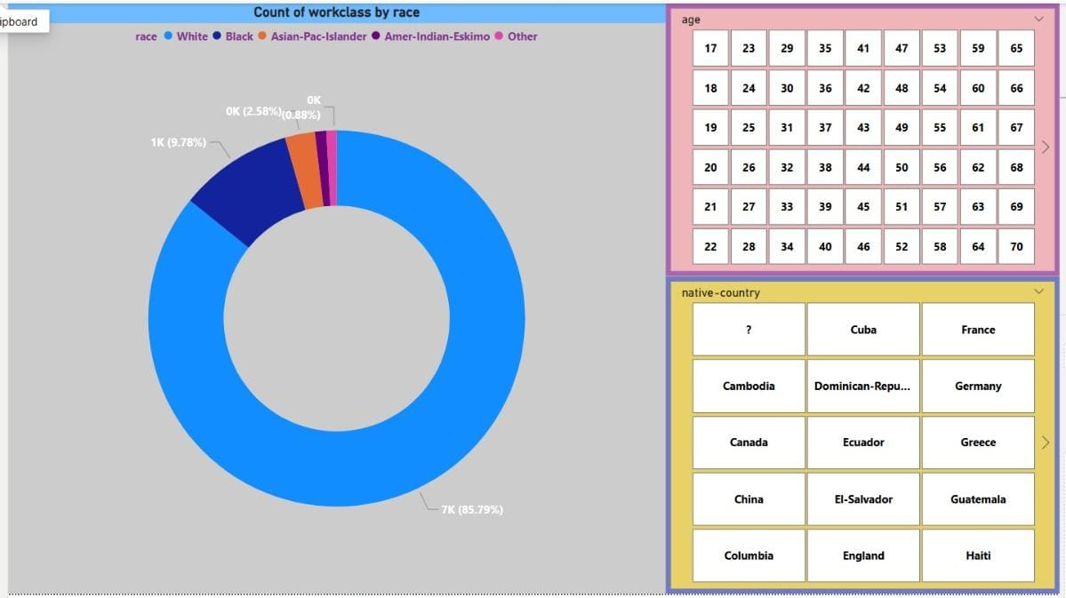
3. Count of work class by race:
The picture contains Donut chart, and two cards.
The clustered Donut chart display the count of work class by race.
Similarly, we see the type of race. like(e.g. White, Black or Amer-Indian Eskimo etc.)
Clicking on the Donut chart we can see the changes of value in card.

Slide 5
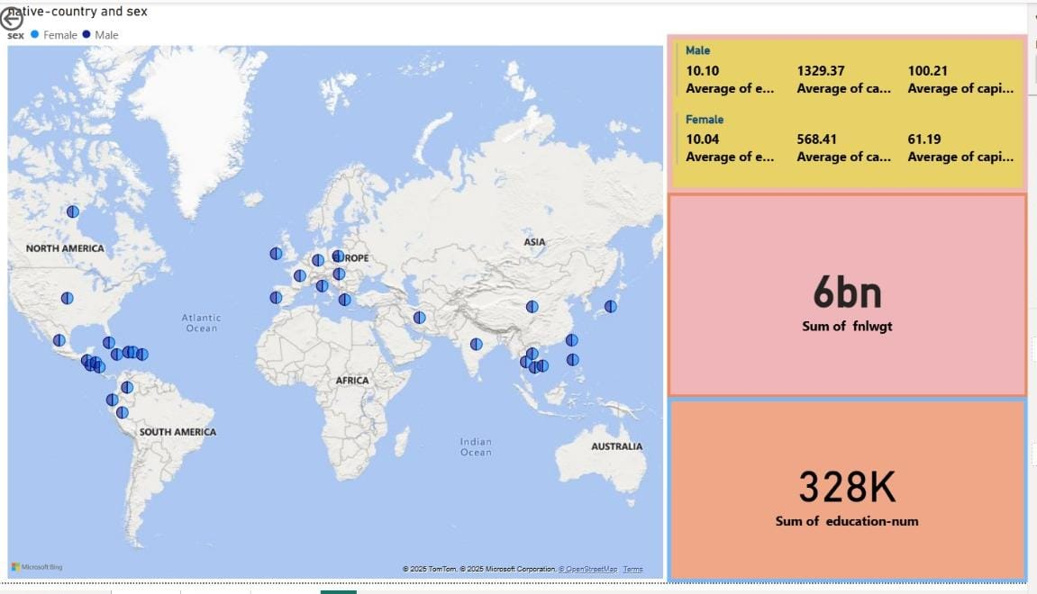
4.native-country and sex:
This picture contains with one world map, 2 cards, one multi-row card.
The map is filled with two colors indicates the difference between sex.(F/M)
By selecting on the particular country on map shows the male and female , Average of education-num
,and sum of fnlwgt.
This action changes all the data in table, card, multi-row card which contains the related data in Average of education-number in male and female.

Slide 6
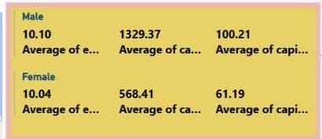
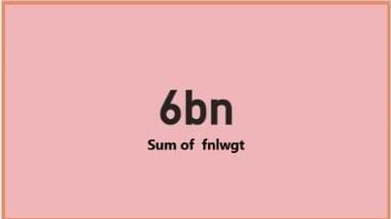
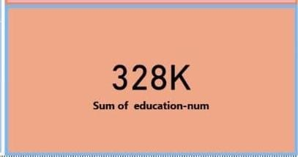
5.multi- row card:
The multi-row card contains the value of education, Average of education-num, Average of capital – gain and Average of capital-loss of sex(F/M).
6.Card:
Here , the card 1 show the value of max of final weight(population) of people.
Here, the card 2 show the value of sum of education number.

Slide 7
Conclusion:
Understanding income evaluation is essential for achieving financial success. By effectively managing income, budgeting wisely, and exploring strategies for growth, you can build a strong financial foundation for a secure and prosperous future.

